Slide 1
PrimeLife Policy Engine From PrimeLife To Cloud Computing
Slim Trabelsi, Jakub Sendor, Stefanie Reinicke and Michele Bezzi
contact: slim.trabelsi@sap.com
SAP Labs Research Sophia-Antipolis

Slide 2
Emergence of Web 2.0 platforms
Notes:
Everyone knows that today web 2.0 applications are attracting the major part of the global internet users. In 2010 Facebook references 500 million active users, Youtube 48.2 million, and 75 million. The particularity of the Web 2.0 applications is of course based on a user-centric model, that means that the users are responsible for publishing the information that should read by the other users. It is easy to guess that the amount of personal data published in the internet is simply terrific.

Slide 3
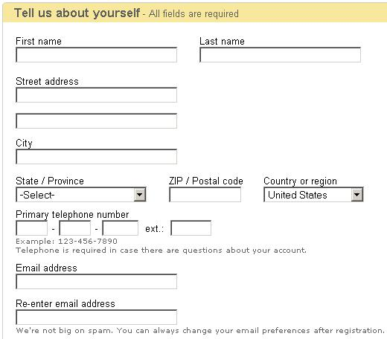
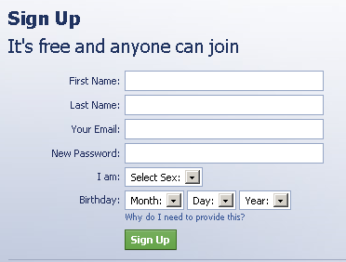
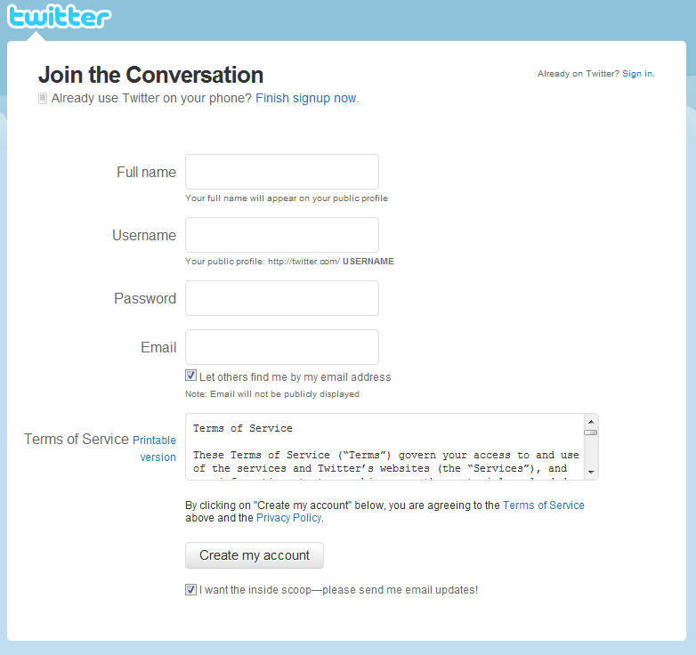
Private Data Collected
Notes:
If not all the private data is published by the users, because some of them have a conscience, most of the data is implicitly collected by the application owners. For example during the creation of a user account.

Slide 4
Questions ?
Is the information necessary for the online activity I am engaging in?
How does the website use personal information once it is collected?
Do I have a choice about the way information about me is used or shared?
What guaranties do I have that the information is protected?
Notes:
But:
Is the information necessary for the online activity I am engaging in?
How does the website use personal information once it is collected?
Do I have a choice about the way information about me is used or shared?
What guaranties do I have that the information is protected?
And generally I’m I controlling the data that I own ?

Slide 5
What Privacy Policies Say ?
Notes:
Of course most of these websites are publishing a privacy policy text in which they describe how the data is handled once it is collected. Let’s have a look to one of these privacy policies (read the slides)

Slide 6
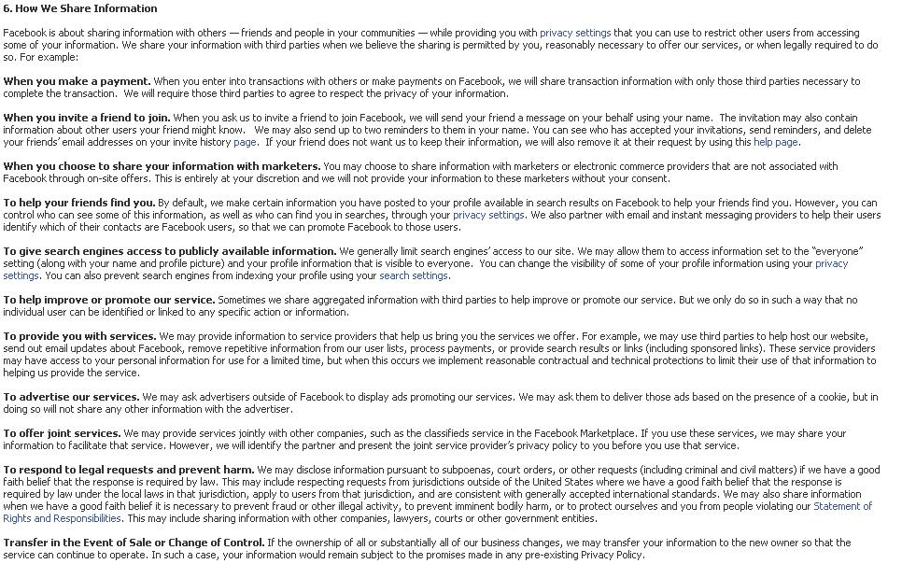
What Privacy Policies Say ?

Slide 7
Not Clear, Boring !!!
So do we need to read each privacy policy for each web site that we are going to communicate with ?!?!
!
!
!
!
!
It’s boring
No one reads it !!!!!!!
Notes:
So do we need to read each privacy policy for each web site that we are going to communicate with ?!?! It is so boaring, and in practice no one reads it !

Slide 8
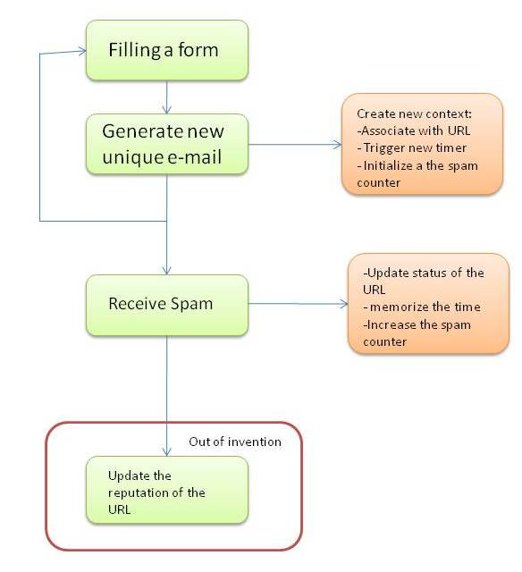
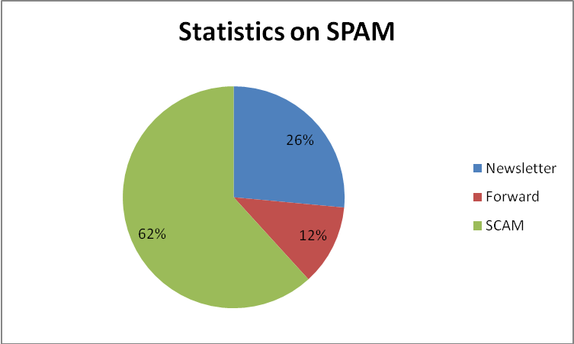
Not Compliant With Their Policies !!
We made a simple empirical study to test if these privacy policies are enforced.
Scenario test case
Resullts
42,85% of the contacted websites are not compliant with their privacy policies. 19,04% of the websites are responsible for SCAM e-mails
Notes:
In order to check if these web sites are really compliant with their statements written in their privacy policies we made a simple empirical study to test if these privacy policies are really enforced.
the scenario test case is quite simple, we created about 30 accounts in famous web 2.0 websites. For each of them we created a unique temporary e-mail address, and we started waiting for the reaction of these web sites in terms of e-mail address usage.
the result was quite surprising, about 42 % of these websites where not compliant with their privacy policies in terms e-mail address usage. Within these 42 % 26% of the non wanted e-mails were related to the web site news letter (although we stated that we refuse to receive the newsletter), 12% shared or e-mail with a third party web site and finally 62% is a malicious SCAM. That means that 19 % of the tested websites used our e-mail address for sending scams.

Slide 9
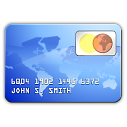
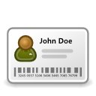
Scenario
Request resource
Request personal data
Services, webpages, resources,…
Request personal data
Personal & Certified Data
Personal data
Personal data
CollectedData
CollectedData
resource
Policy Engine
Policy Engine
Policy Engine
Alice

Slide 10
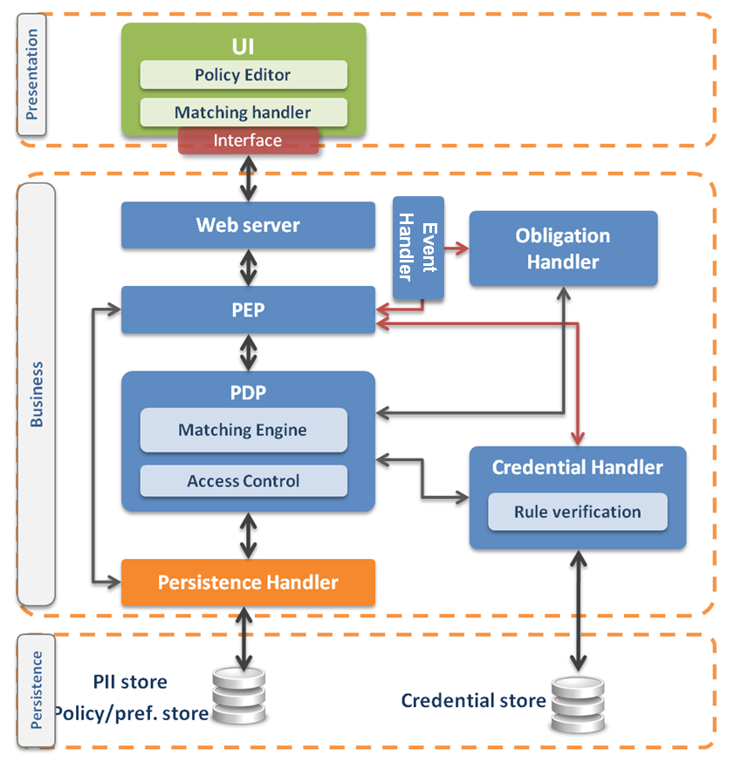
Sticky Policy : Data-centric access and usage control
Identified Problem
Access control mechanisms control the paths to access the data, but typically many paths available, with the risk of leaving some open doors.
In distributed data processing, each actor has to access and process data according to different conditions. Current centralized access and usage control systems are not able to fulfill this requirement.
Limitation on data usage not explicitly considered
Solution
Binding access control and usage policy with the data (sticky policy). Sticky policies travel with the data along the chain.
Support for automated enforcement
Features
Sticky policy covers:
Access control
Data Handling conditions (e.g., privacy)
Additional obligations (e.g., inform the user when his personal data are shared with a third party)
Policy travels with data (downstream usage)
Automated invocation & enforcement

Slide 11
Business Model
Do the web 2.0 users care about privacy protection? Are they ready to pay for privacy?
What should force the servers to implement such technology?
Adam Shotack insists on the complexity of perception for the privacy, “different people use the word [privacy] to mean different things”
This lack of awareness does not motivate the user to pay to protect his privacy.
The business model for privacy becomes slightly different when the data collected is owned by companies.
These companies know exactly the price of the privacy of such sensitive data
They can evaluate the amount of money they are risking to lose if such data is lost or made public.
companies are for guarantees in order to trust the cloud platform.
Guarantees proving that their data will not be shared with concurrent companies, that the cloud host will not use this data for his personal purpose (like statistics and other analysis).

Slide 12
PPL for the Cloud
Requirements
The current implementation of the PPL engine is not SECURE
Obligation engine and Event Handler are not protected
Access to the database is not restricted
No guarantees for a correct enforcement
No guarantees that collected data will not be copied or duplicated etc.
Trust is missing
How to establish a trust relationship between the Cloud provider and the client ?
The current solution is NOT SCALABLE
It works for 10 or 100 data in the DB, not feasible for hundreds of Tbytes
Checking policies, matching, event handling obligation enforcement etc.

Slide 13
PPL for the Cloud
Certifying the secure privacy component
Trust is the essential part of the cloud paradigm
Data owner needs a guarantee from a trusted authority (Governmental office, EU commission etc.)
Guarantee that the cloud provider is compliant with regulations
Trusted authority must certify the secure privacy component in charge of enforcing sticky policies
Trusted authority must perform audits in order to verify if the host is not misusing the stored data.

Slide 14
PPL for the Cloud
Tamper-proof secure privacy component
How to ensure that AC and obligations are correctly enforced ?
Protecting the engine from modifications
SOLUTION: Temper proof software
Tampering by either the normal users of a product, package, or system or others with physical access to it.
How to ensure that DB is accessed according to user’s preferences ?
SOLUTION: Certified APIs to access DB
API compatible with Event Handler specifications.
Make audits clear and easy
The advantage of using the secure privacy component
Facilitate the audit task for any trusted authority during the compliance verification
Clear confidence zones (out of the green zone is illegal)
Remote control for the data
Possibility to provide a monitoring console for data owners

Slide 15
Conclusion
When private and sensitive data is used and distributed through multiple services and domains => the control becomes very complicated
Sticky policy paradigm offers an interesting solution for data centric access and usage control
Not applicable for Web 2.0 systems
Cloud computing as one of the best business model
New requirement for cloud
Security
Trust
Scalability
Usability

Slide 16
Thank you!

